Slide 1
USB Gain/Phase Analyzer
Interim Report

Slide 2
USB Gain/Phase Analyzer
Requirements
Design
Prototyping
Schedule
Budget
Next Steps

Slide 3
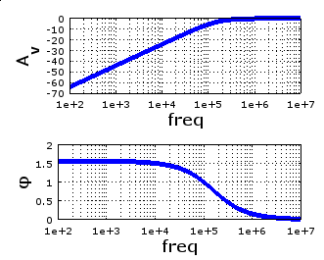
Purpose
Test the frequency behavior of filters, amplifiers
Generate Bode plot with
amplitude and phase

Slide 4
Requirements
Displays Bode plot on a PC
Frequency Range: 1 kHz to 150 MHz
Amplitude up to 1.25 V RMS
Phase response
Detect signals down to 60 dB below input

Slide 5
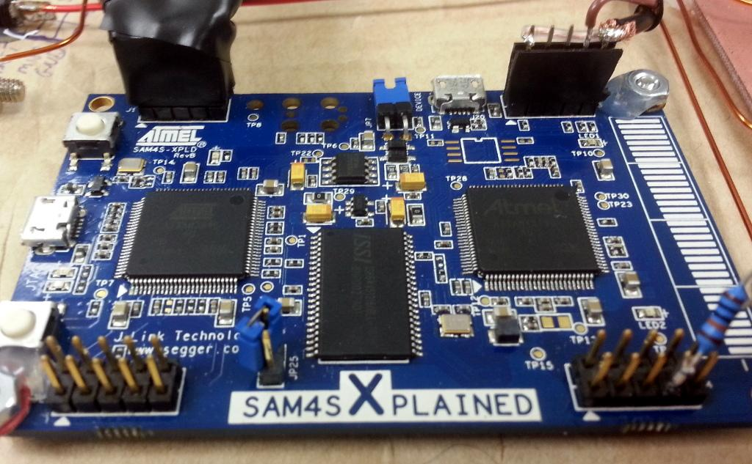
Design — Software
PC software
User software sends commands to the GPA
Received data is plotted using matplotlib
Microcontroller software
ARM Cortex-M4 microcontroller drives the system
Hardware interfaces with the PC over USB

Slide 6
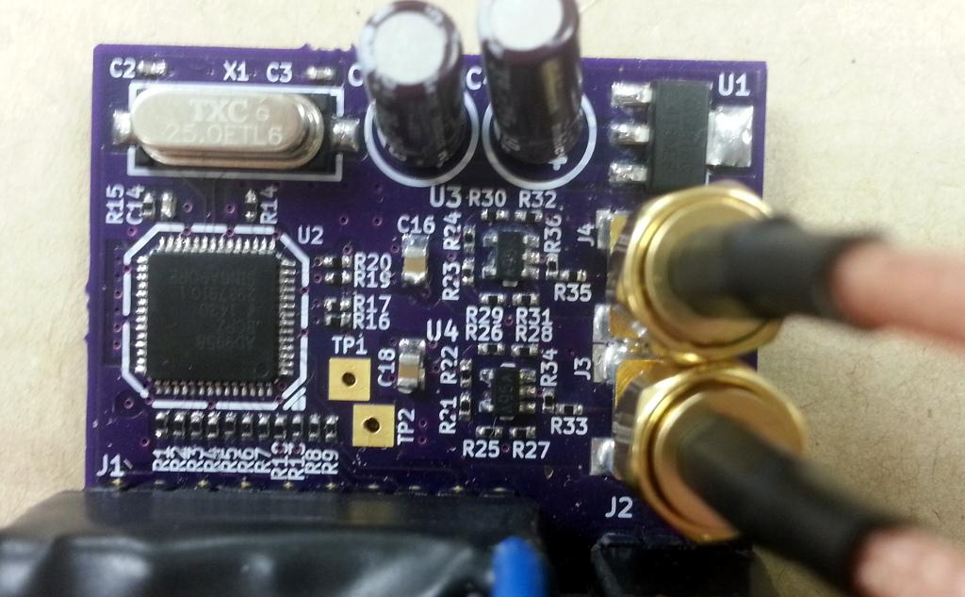
Design — Signal Generation
Frequency range: 1 kHz to 150 MHz
Analog Devices AD9958: dual 500 MSPS sine wave synthesizer
f_{s}/2 = 250 MHz
no lower limit

Slide 7
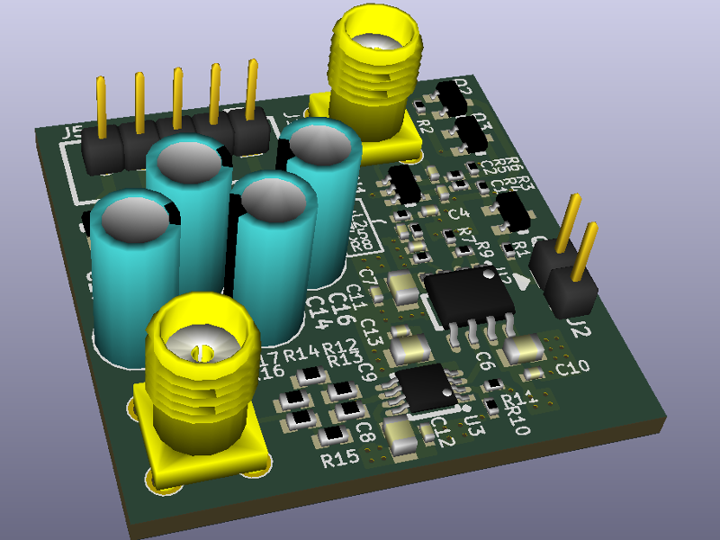
Design — Signal Output
Amplitude range: up to 1.25 V RMS or 15 dBm
Two-stage output amplifier: RF op amps
Synthesizer outputs -8.5 dBm
Each stage 15.5 dB: 22.5 dBm maximum
Margin!

Slide 8
Design — Phase Detection
Tests phase response
Second synthesizer output (this is the phase reference) is combined with input signal
Sweep phase to find the null

Slide 9
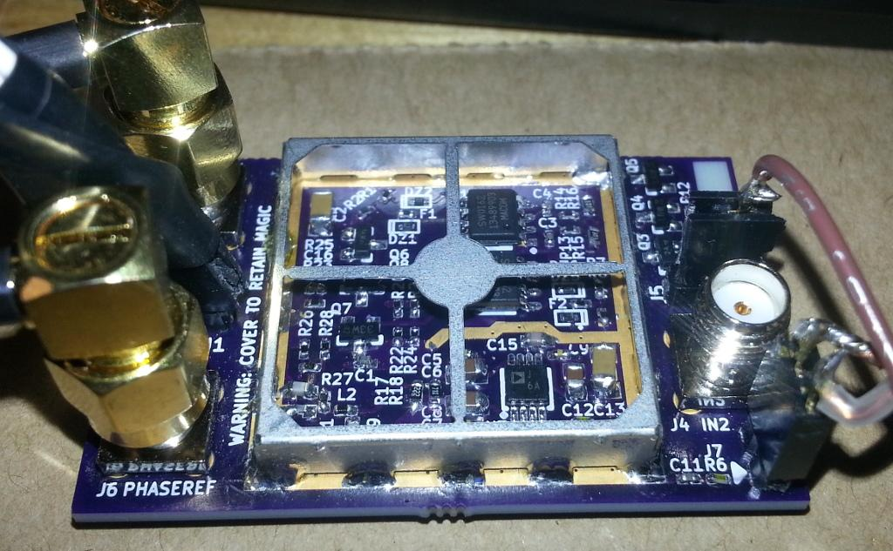
Design — Detection
Must detect signals down to 60 dB
Low-noise frontend:
Wideband buffer isolates input from…:
Power combiner: sum in the phase reference
AD8310 logarithmic amplifier: 95 dB range
RF shield: blocks radio interference

Slide 10
Schedule
Item | Start Date | End Date | Percent Complete
PRS | 2014-10-03 | 2014-10-17 | 100%
PDP | 2014-10-17 | 2014-10-31 | 100%
Architecture Presentation | 2014-10-31 | 2014-11-14 | 100%
Interim Report | 2014-11-14 | 2014-12-05 | 100%
Proto. built | 2014-11-14 | 2014-12-05 | 100%
Proto. firmware | 2014-11-10 | 2014-12-05 | 100%

Slide 11
Budget
Item | Expended | Actual | Est. to Completion | Est. at Completion
Synthesizer | $60 | $60 | $0 | $60
Input | $70 | $70 | $0 | $70
Output amp. | $66 | $66 | $0 | $66
Power supply | $0 | $0 | $0 | $0
Final build | $0 |  | $120 | $120
Enclosure | $0 |  | $30 | $30
Misc/re-spins | $0 |  | $100 | $100
Total | $196 | $196 | $250 | $446

Slide 12
Next Steps
Hardware
Combine prototypes into a final product
Software
Finish firmware with full analysis capability
Write PC software that receives and plots data

Slide 13
Conclusion
Product can capture Bode plots
Uses signal synthesizer, output amplifier, input frontend, ADC, and microcontroller
These have been prototyped and tested

